Slide 1
Understanding Station Usage Patterns
Prepared for Amey Consulting
Faheem Ul-Haque

Slide 2
Objectives
Understanding station behaviour
Identify natural station groups
Forecast 2026 demand
Detect and suggest reasons for unusual usage patterns

Slide 3
The Data
Daily entry and exit tap counts
437 stations
From 01/01/2024 to 30/11/2025

Slide 4
How Stations Differ
Objective : Understanding Station Behaviour
Average Daily Volume: The average number of passengers entering or exiting the station every day | Seasonal Trends: Some stations see a decrease in volume during the Christmas or Easter period
Weekly Trends: There are stations that see decreases in volume on weekends | Overall Volume: The number of passengers entering or leaving the station over the course of the entire timeframe

Slide 5
How Stations Differ
Objective : Understanding Station Behaviour
Feature Engineering:
We used a total of 22 different usage features, including those on the previous slide, to create a behavioural profile for each of the 437 different stations.
Clustering:
We then used a machine learning algorithm called K-Means to cluster together stations that behave similarly.

Slide 6
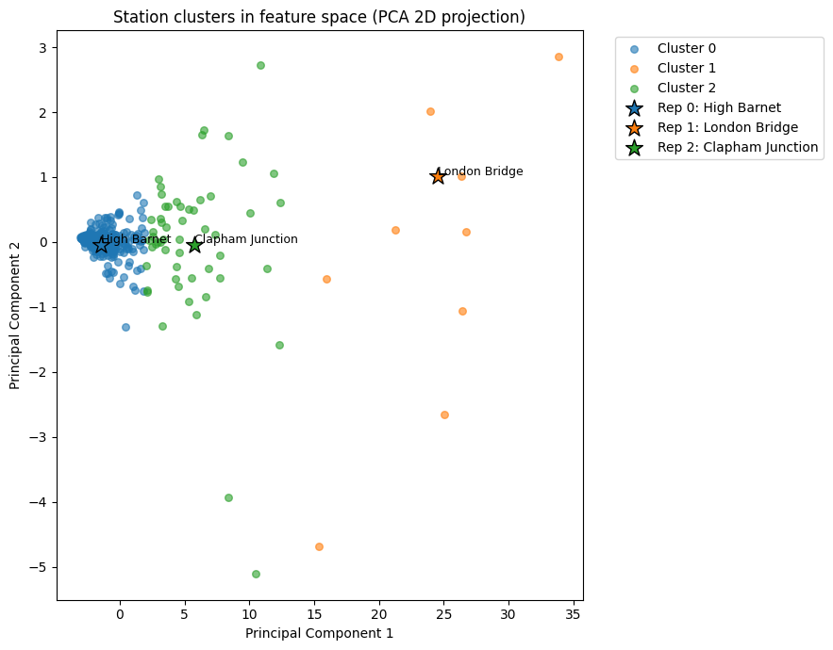
Objective : Understanding Station Behaviour & Identifying Natural Station Groups

Slide 7
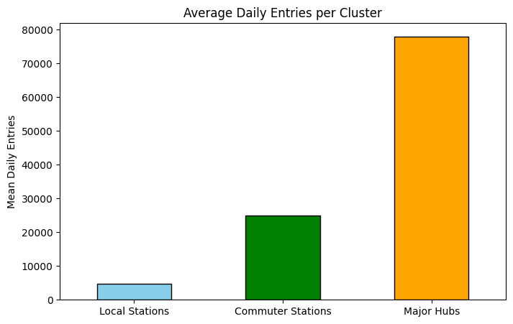
Objective : Understanding Station Behaviour & Identifying Natural Station Groups

Slide 8
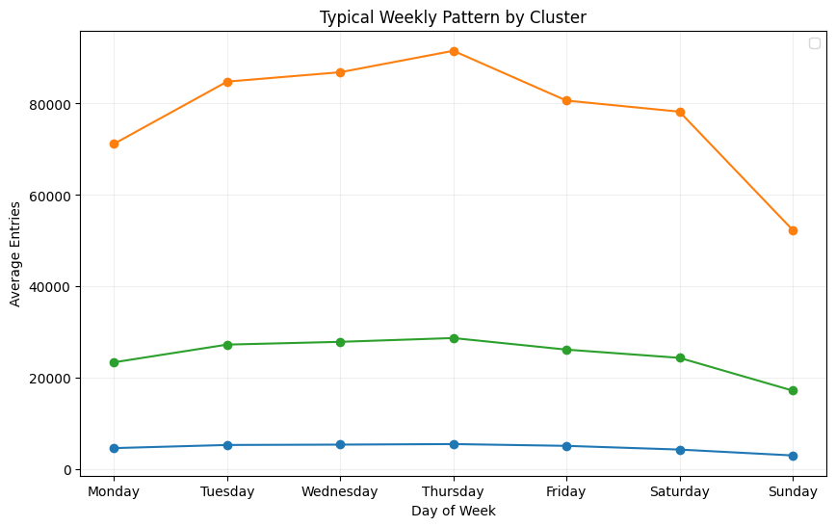
Objective : Understanding Station Behaviour & Identifying Natural Station Groups

Slide 9
Objective : Forecast 2026 Demand

Slide 10
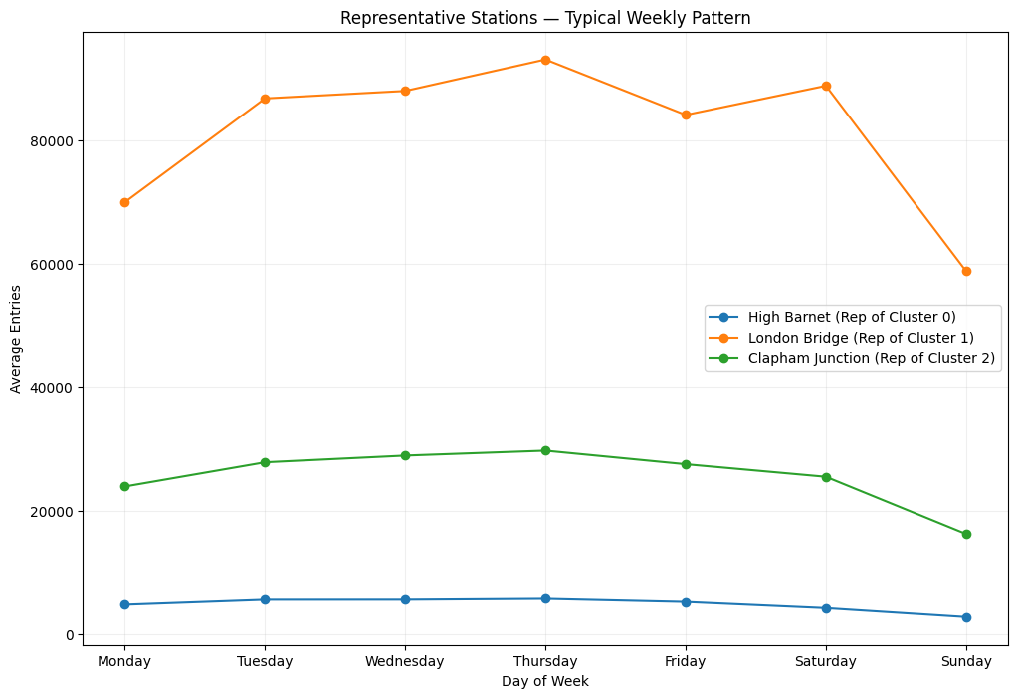
Objective : Forecast 2026 Demand

Slide 11
Objective : Forecast 2026 Demand

Slide 12
Forecasting
Objective : Forecast 2026 Demand
To forecast the demand for 2026 across the 437 stations in a way that is easily digestible we have created a forecast of each of the three representative stations.
We have used a machine learning model for time series forecasting that utilises a decomposable model with trend, seasonality and holiday components.
These forecasts will show dips in the Easter, August and Christmas periods

Slide 13
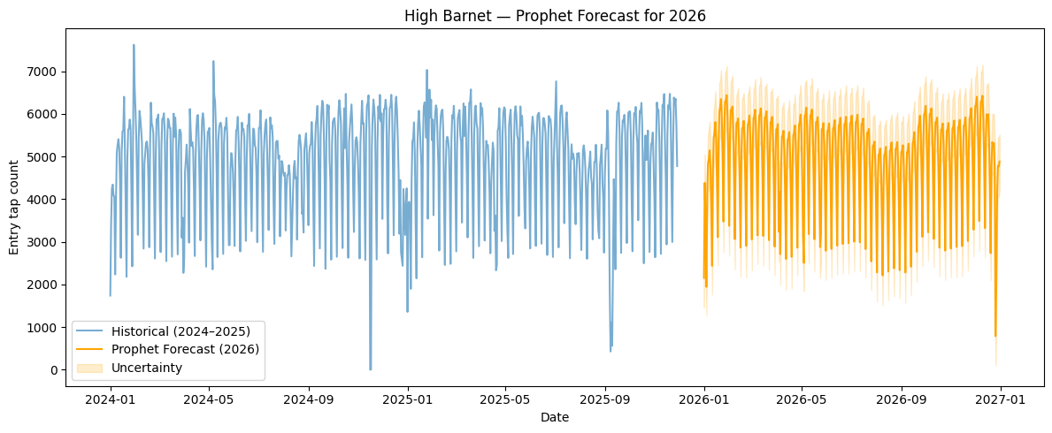
Objective : Forecast 2026 Demand

Slide 14
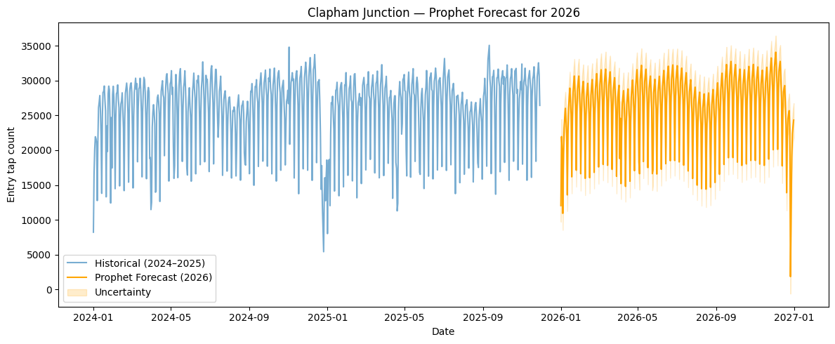
Objective : Forecast 2026 Demand

Slide 15
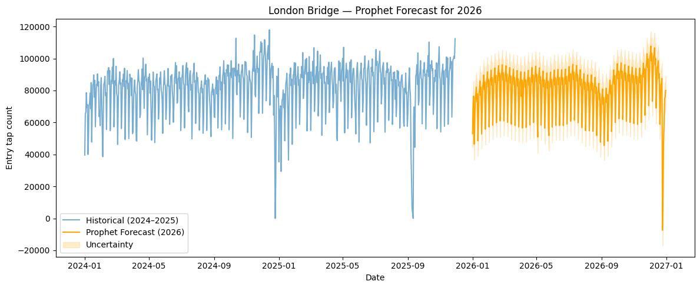
Objective : Forecast 2026 Demand

Slide 16
Anomalies
Objective : Detect and Suggest Reasons For Unusual Usage Patterns
Residuals:
For each of the stations we have found what a typical week looks like, and the general trends. We then remove all of the regular and weekly patterns (Mon-Fri peaks, weekend dips) so that we are only left with the irregular parts. This irregular part is what we call a residual.
Percentile Approach:
We then looked at these residuals and marked the top 1% busiest, and bottom 1% quietest residual days. This will mark the most extreme days compared to what each station normally sees.

Slide 17
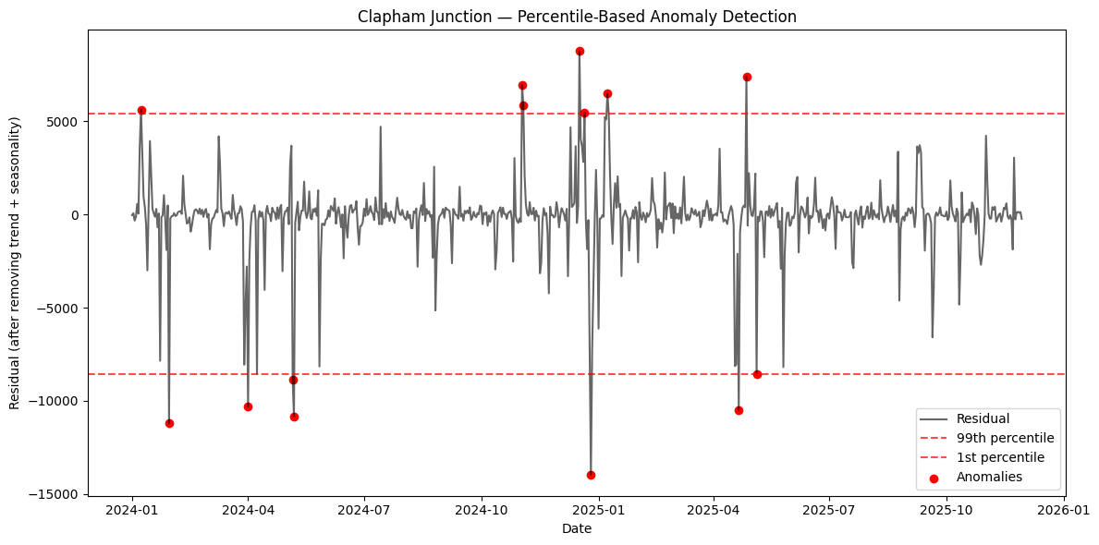
Objective : Detect and Suggest Reasons For Unusual Usage Patterns

Slide 18
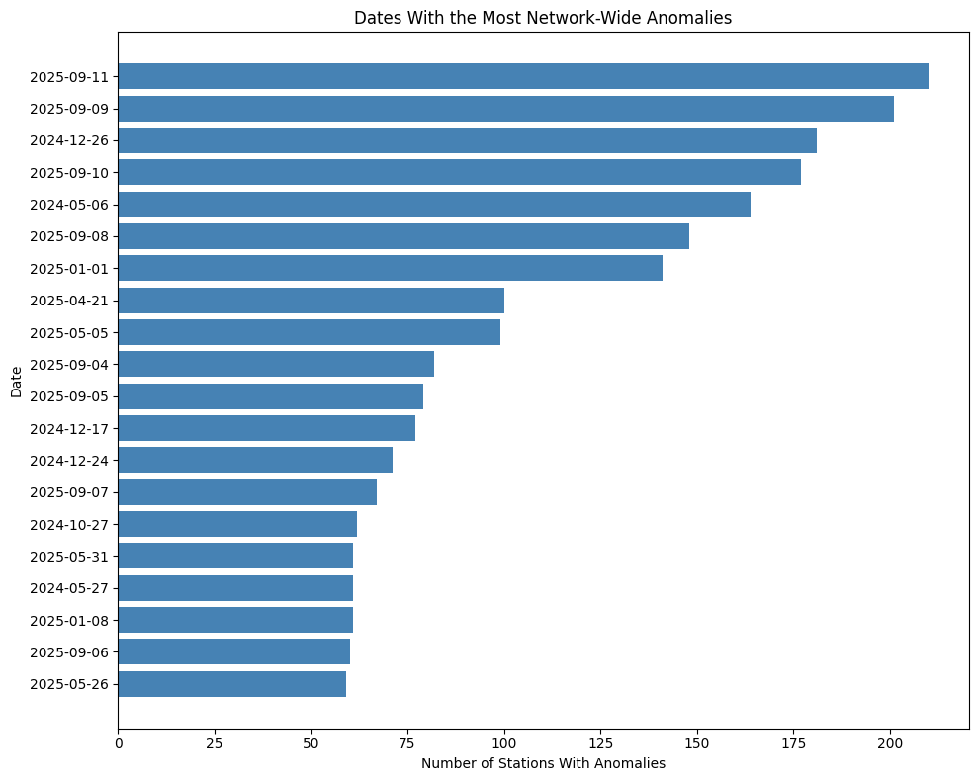
Objective : Detect and Suggest Reasons For Unusual Usage Patterns

Slide 19
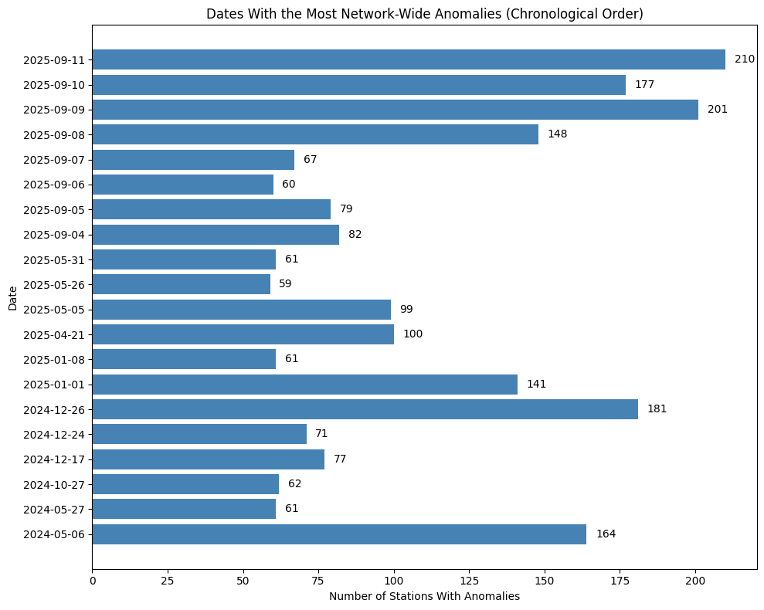
Objective : Detect and Suggest Reasons For Unusual Usage Patterns
Train strikes during the first 2 weeks of september this year caused large disruptions, primarily affecting London Underground

